Slide 1

e-Power
Admin Module
March 2012

Slide 2



What is the Admin Module?
The Admin Module provides access to the following areas
Service Fee Module
Define Mark Up’s/Discounts
Define Service Fee’s
Define Credit Card Fee’s
Members Area
Search for Members
Create new Members manually
Reports
View & Report on bookings

Slide 3
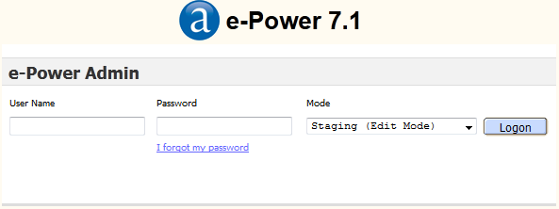
Access the Admin Tool for Service Fee’s
To Define Fee’s, Mark-Up’s or Discounts, visit:
http://admin.amadeusepower.com/
Enter your provided logon credentials
Ensure ‘Staging’ mode is selected.

Slide 4
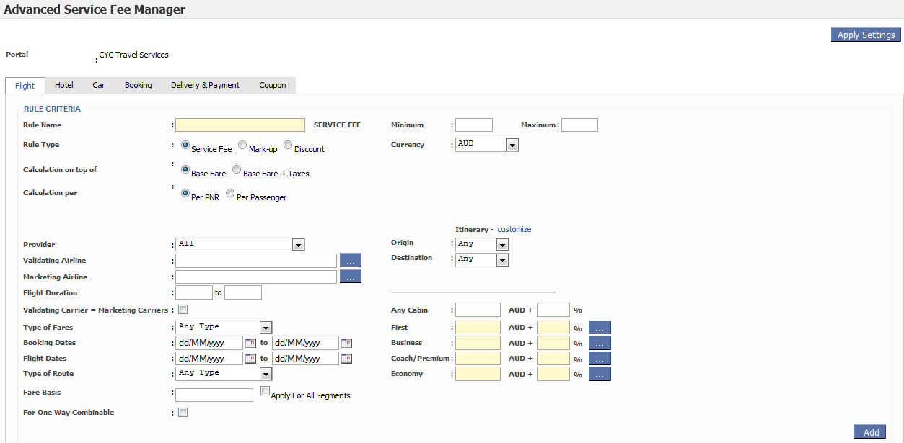
Service Fee Module
Select Portal → Advanced Service Fee Module
For More Information See Separate Service Fee Presentation

Slide 5
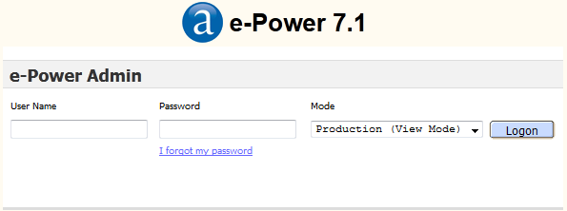
Access the Admin Tool for Members & Reports
To access the Members & Reports area, visit:
http://admin.amadeusepower.com/
Enter your provided logon credentials
Ensure ‘Production’ mode is selected.

Slide 6
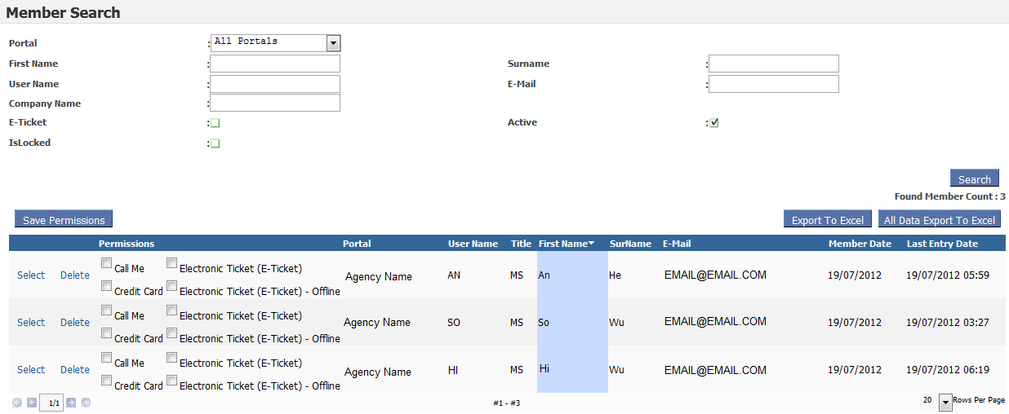
Membership Module
Within Members Module you can:
Search for Registered Members
Create Members
Delete / Modify / Lock / Reset Passwords

Slide 7
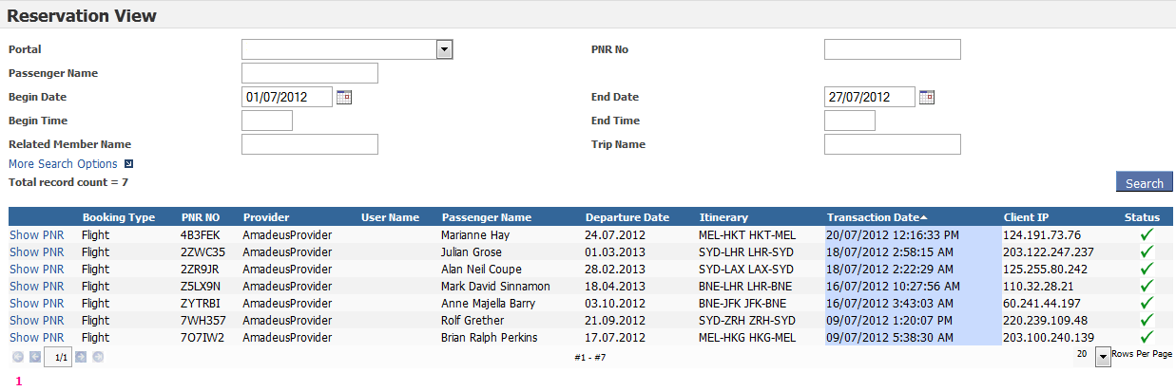
Reporting Module
Within Reports Module you can:
Run reports by date or date range
See & keep track of bookings
Different search options available

Slide 8
Questions?
Why can I see Promotion module?
Promotion module is available to this admin access but not yet released to AU/NZ/NC
What if I forget my password?
Use the forgot my password link
What is Portal Version Manager in admin drop down?
You will use this when publishing fares into production. See Service fee Module.
For anything else, contact us at e-support@au.amadeus.com

Slide 9
Brighter, Bolder, Better
© 2010 Amadeus IT Group SA

